Slide 1
Formula SAE
Powertrain
33% Hardware Update
Damian Boniella, Matt Gingold, Tobin Lanford, Joey LeBlanc, Lucille Longhurst

Slide 2
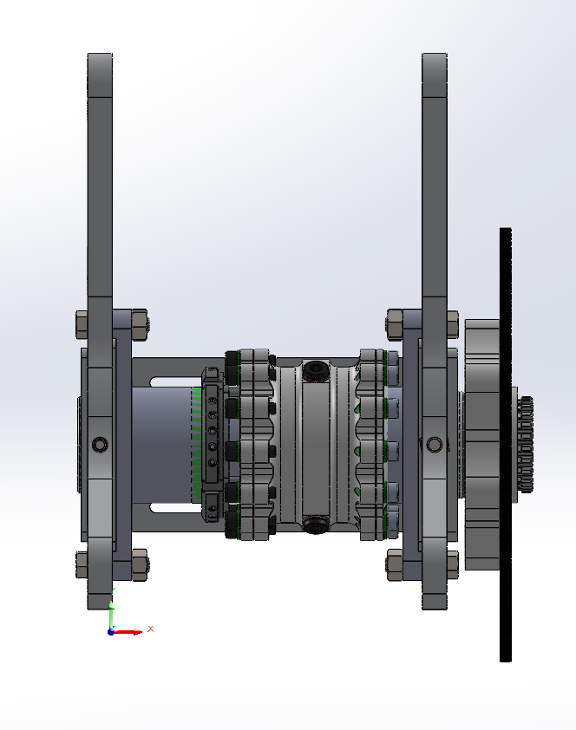
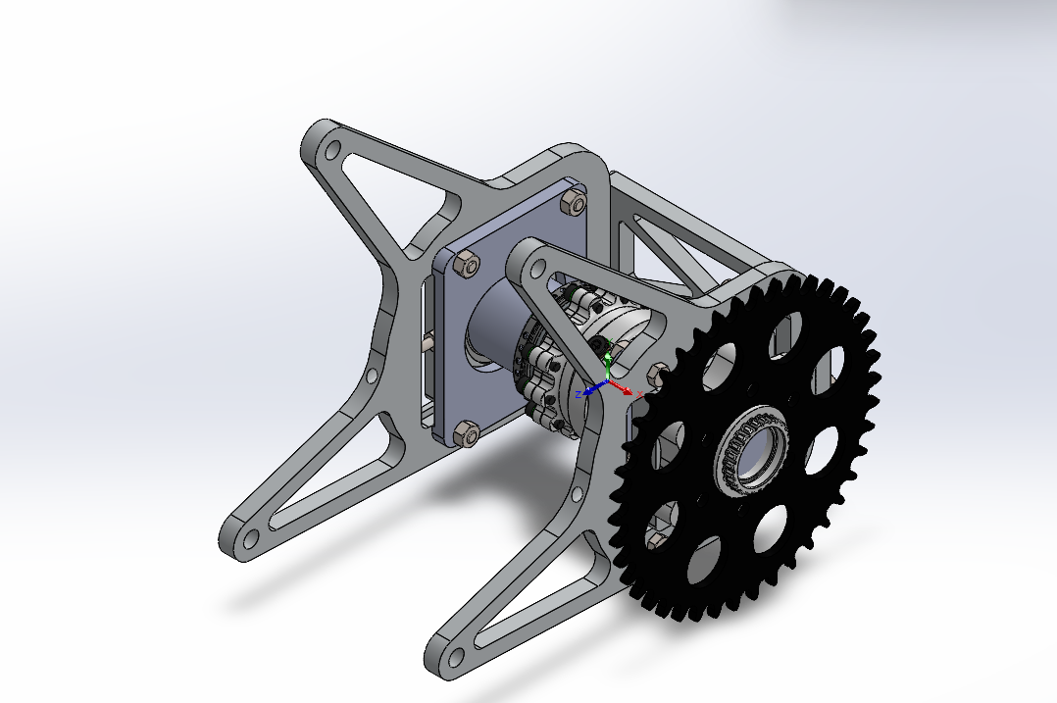
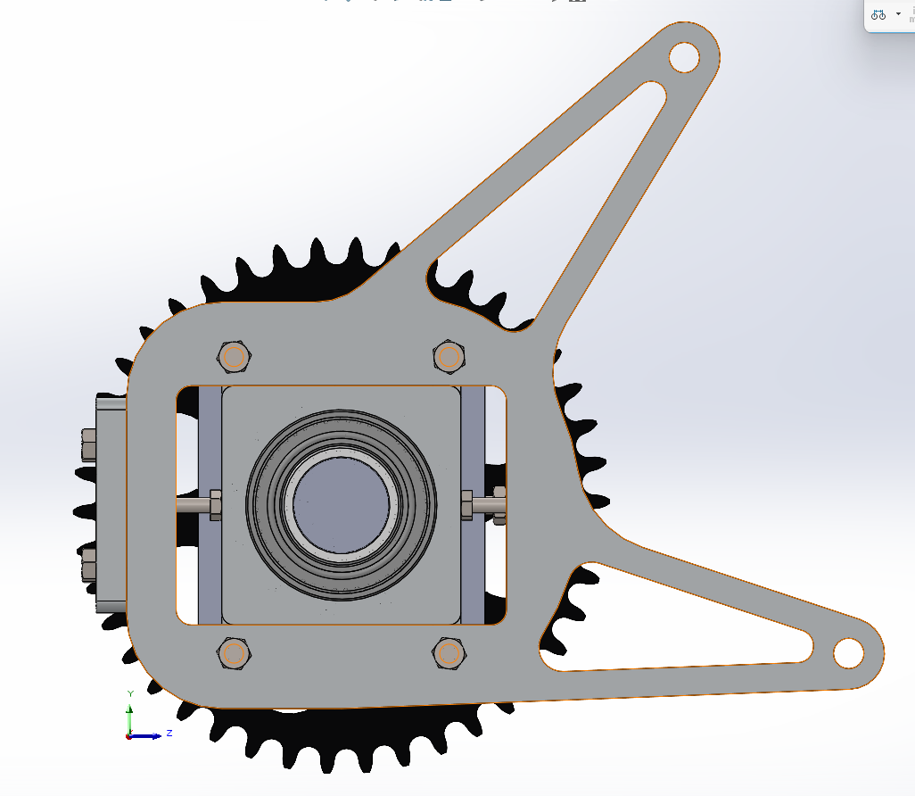
Design Efforts: Differential Assembly

Slide 3
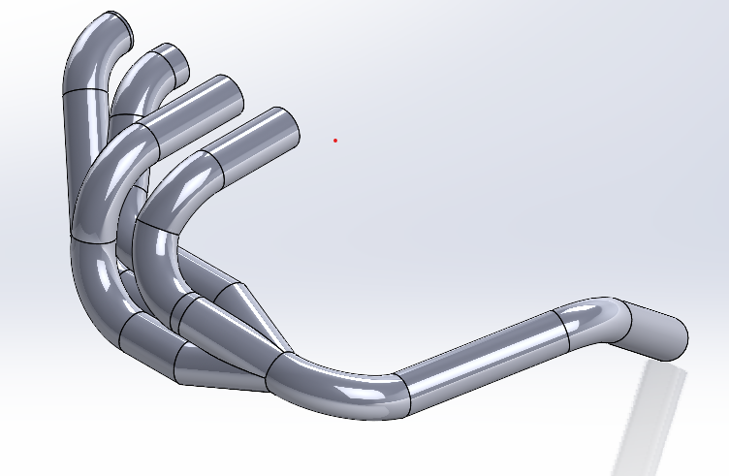
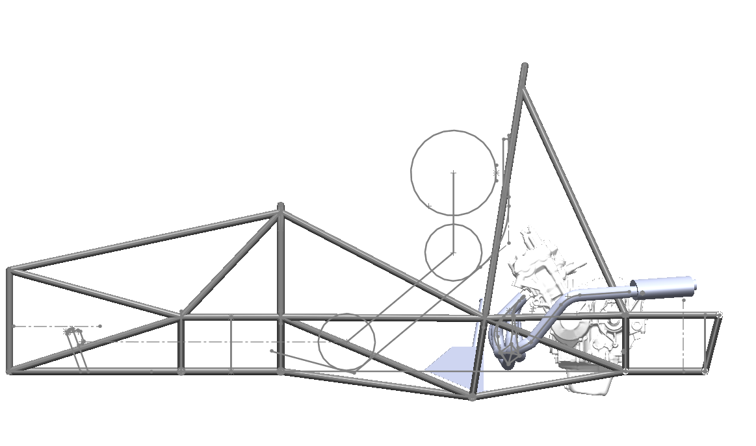
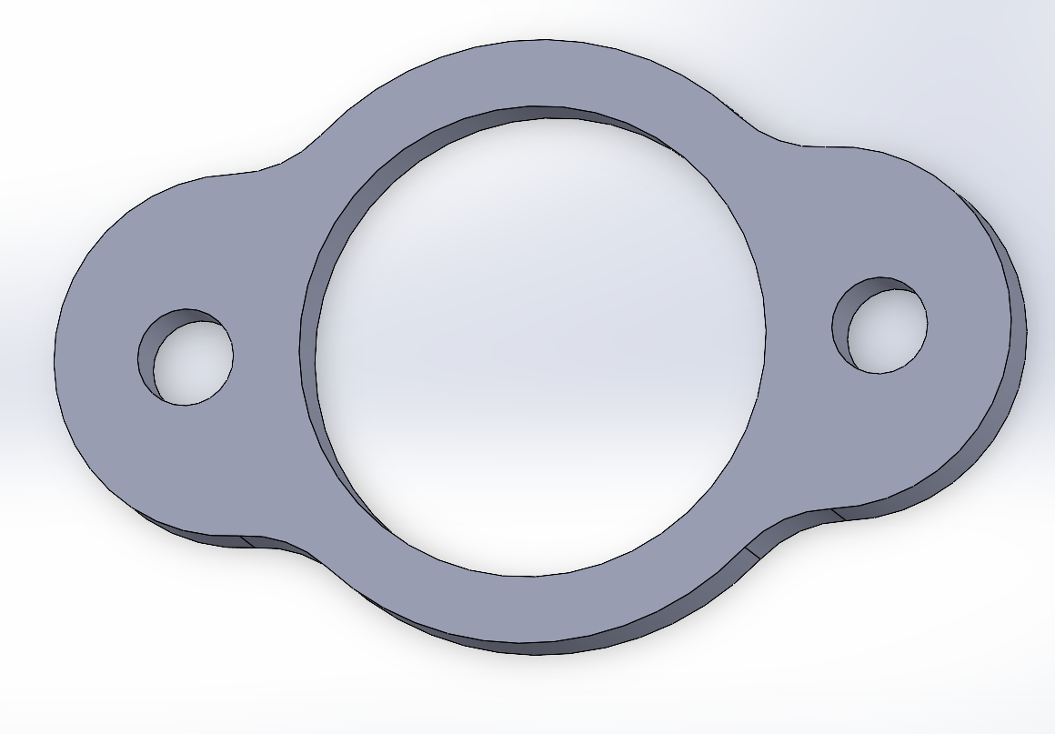
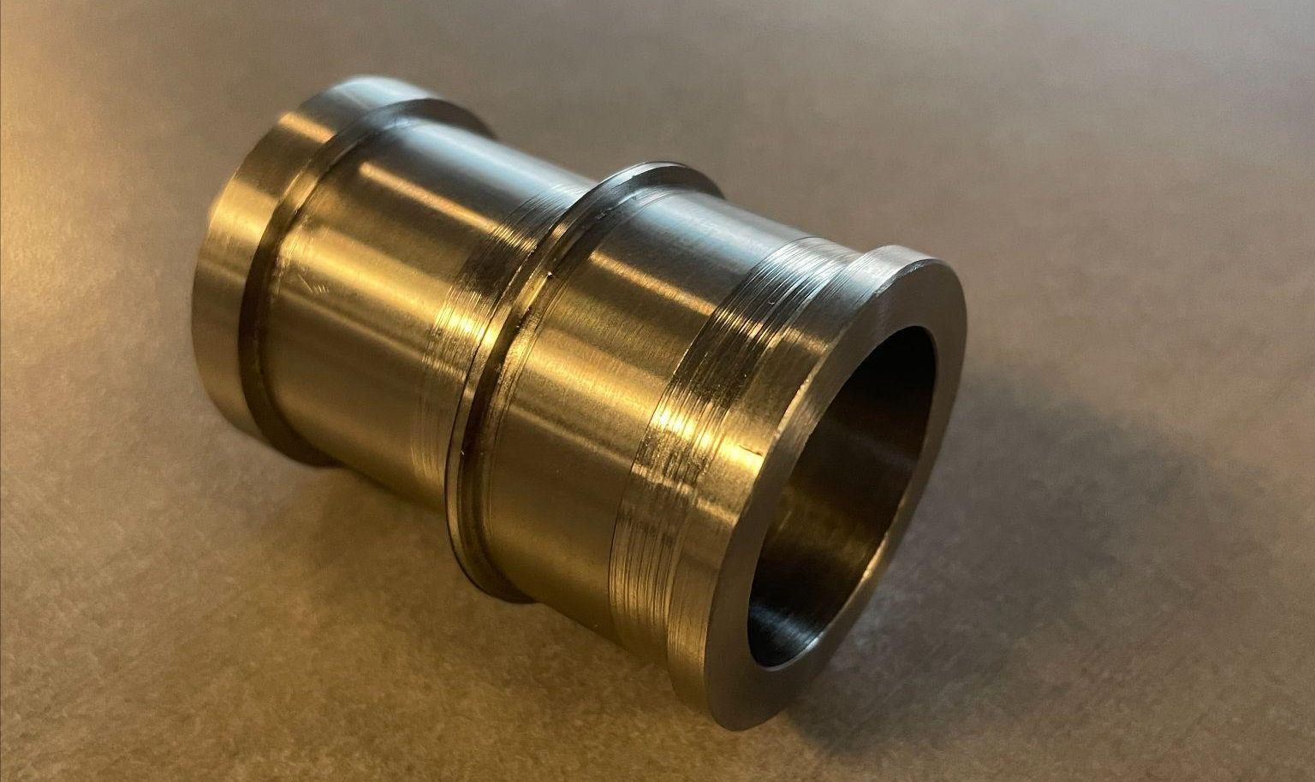
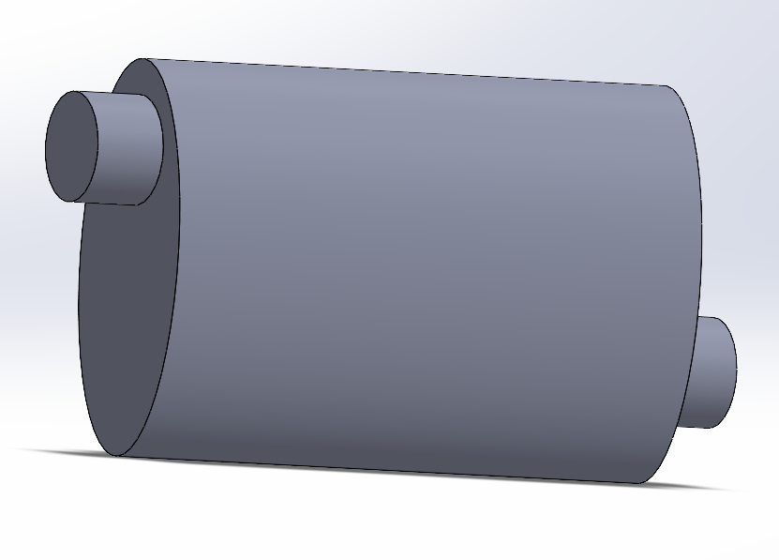
Design Efforts: Exhaust Assembly

Slide 4
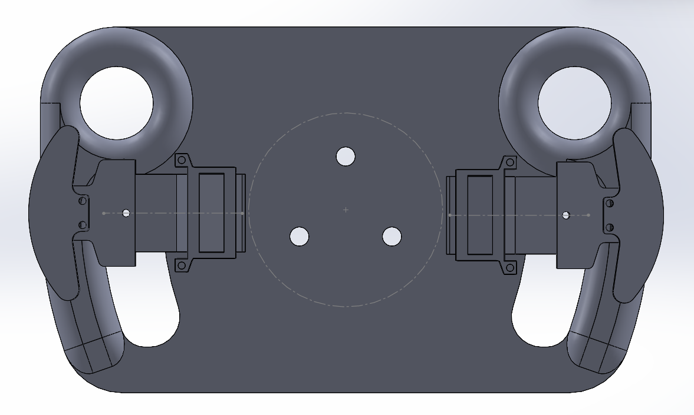
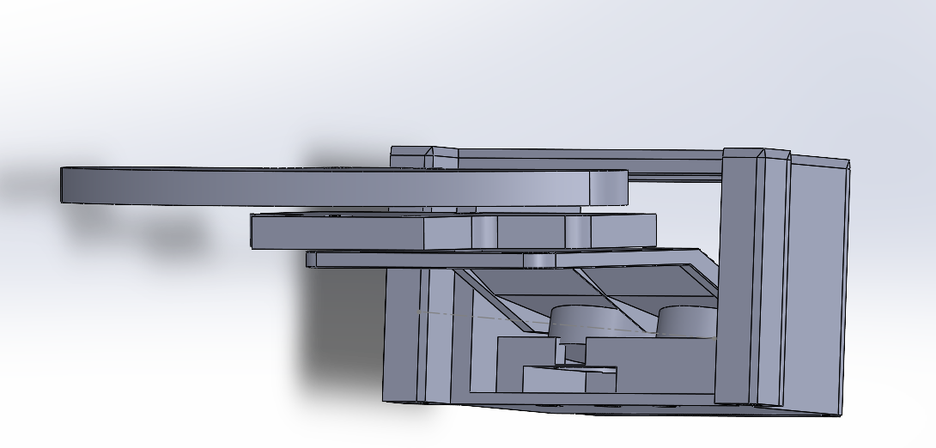
Design Efforts: Shifting System Assembly

Slide 5
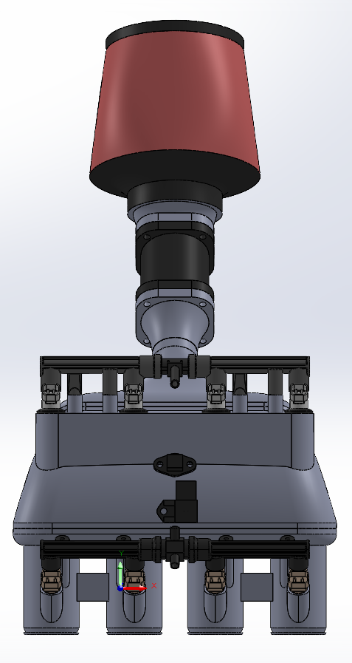
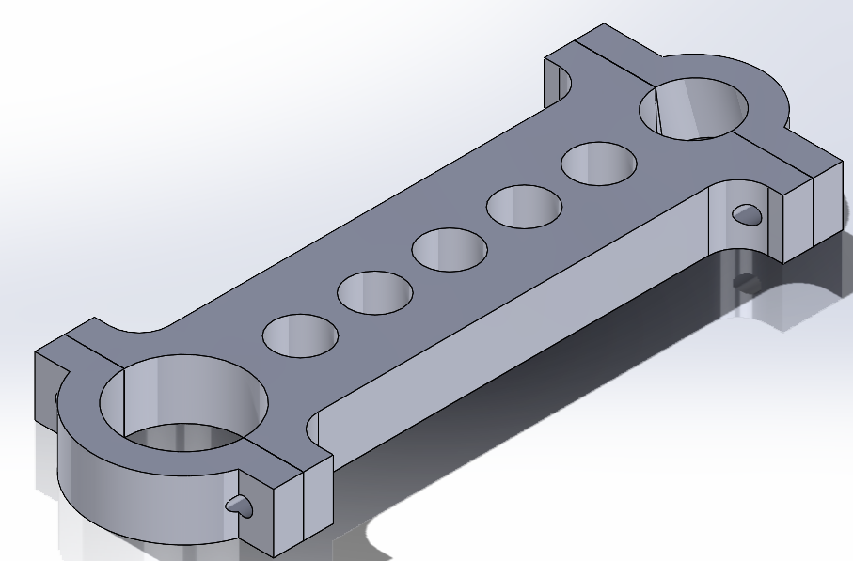
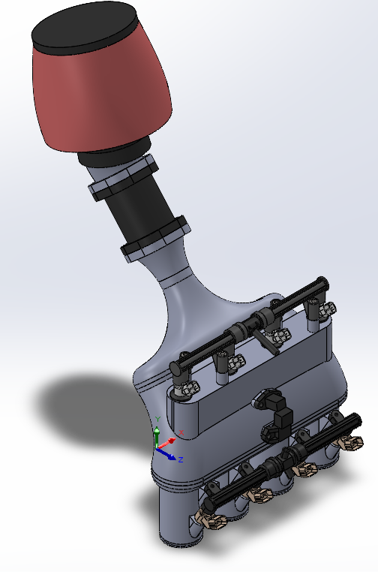
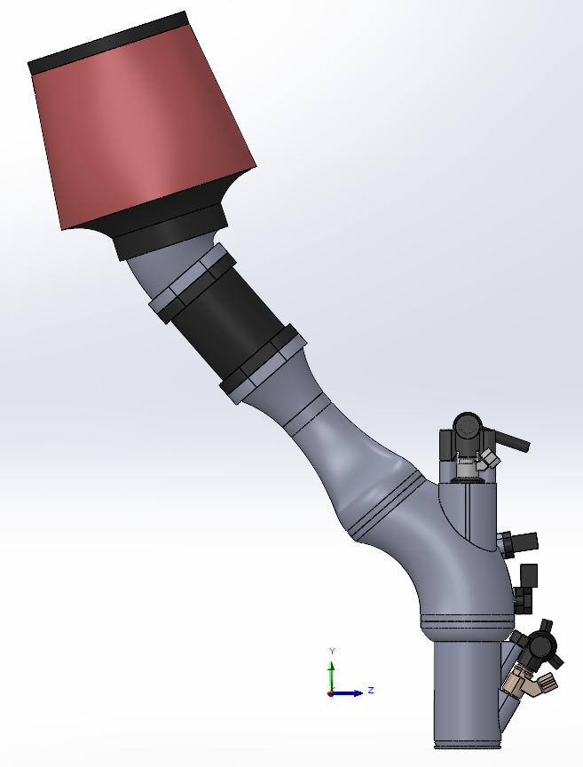
Design Efforts: Intake Assembly

Slide 6
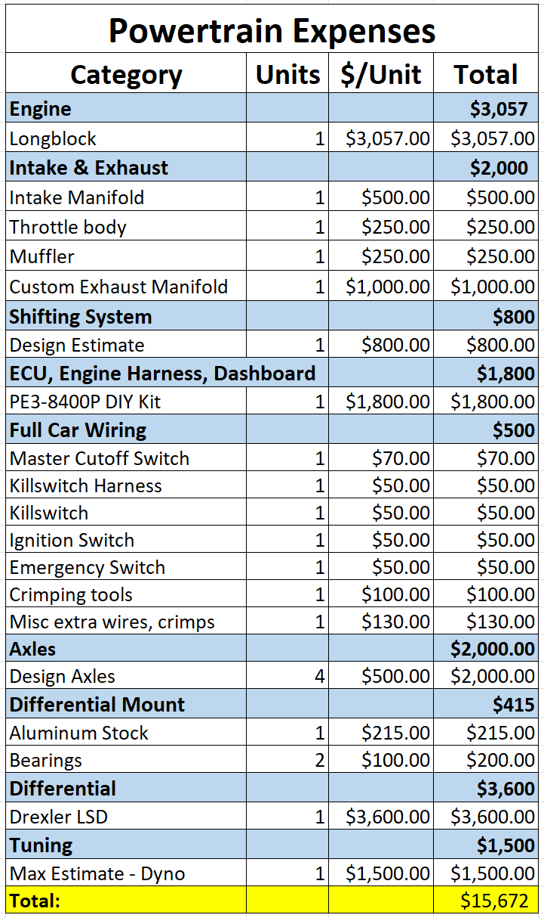
Top Level Budget

Slide 7
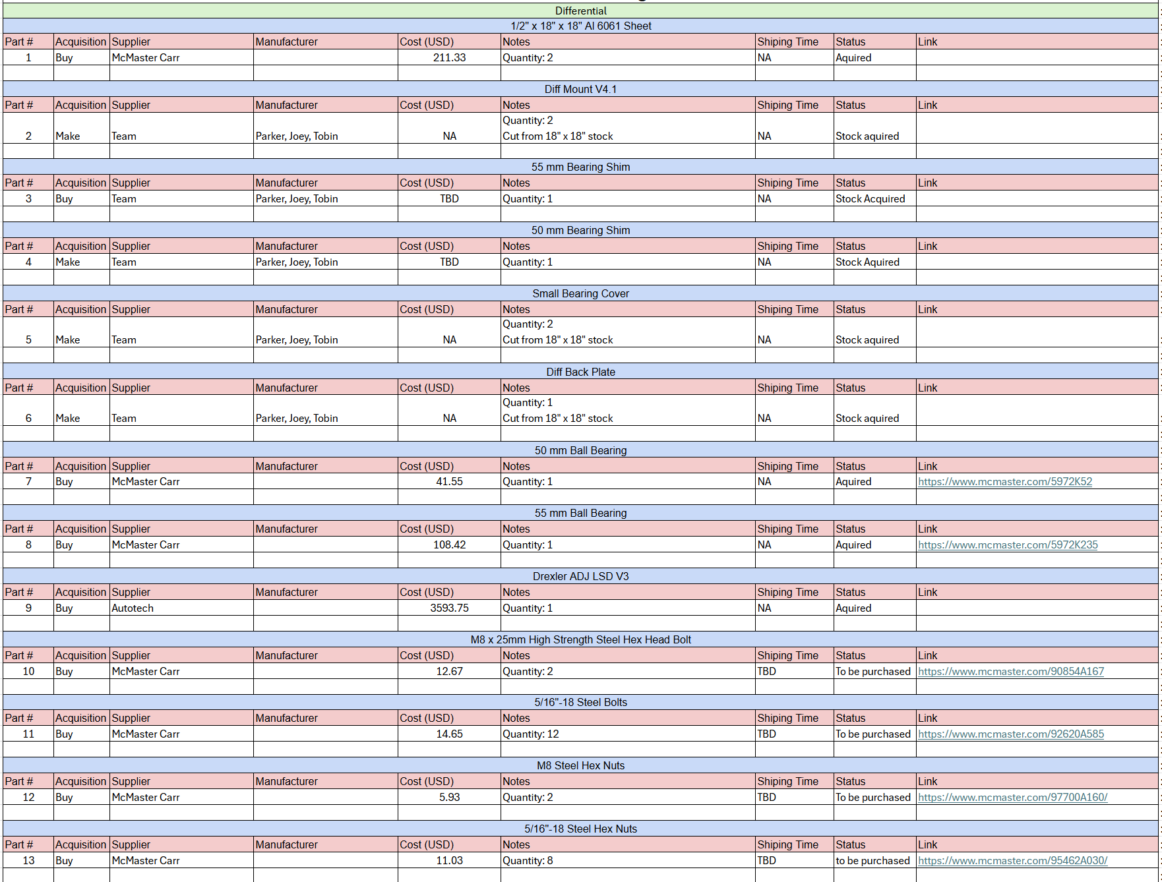
Purchasing Plan - Diff Mount

Slide 8
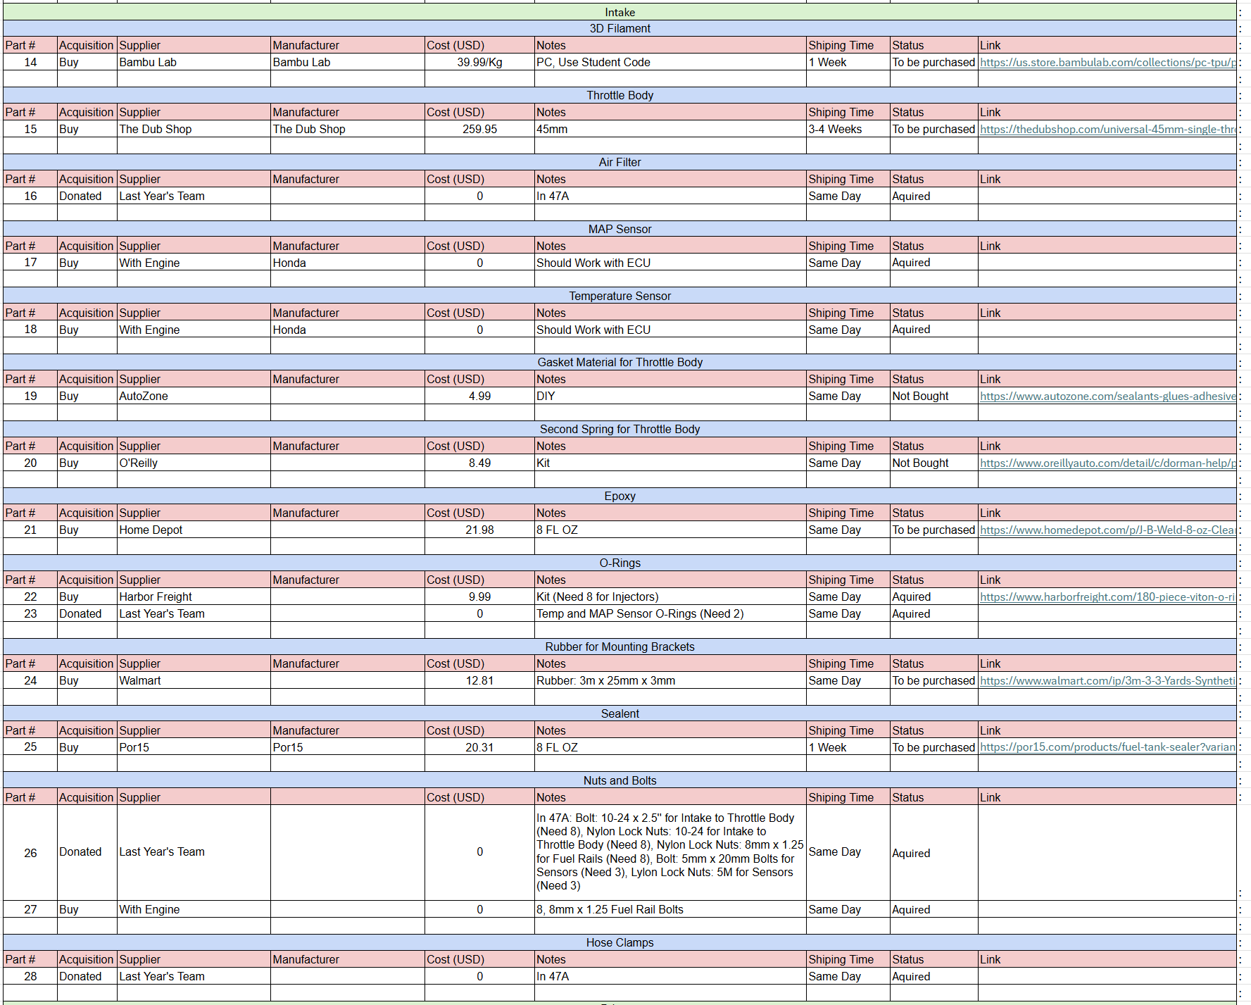
Purchasing Plan - Intake

Slide 9
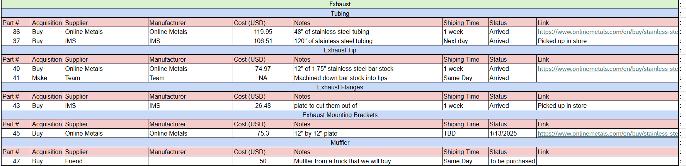
Purchasing Plan - Exhaust

Slide 10
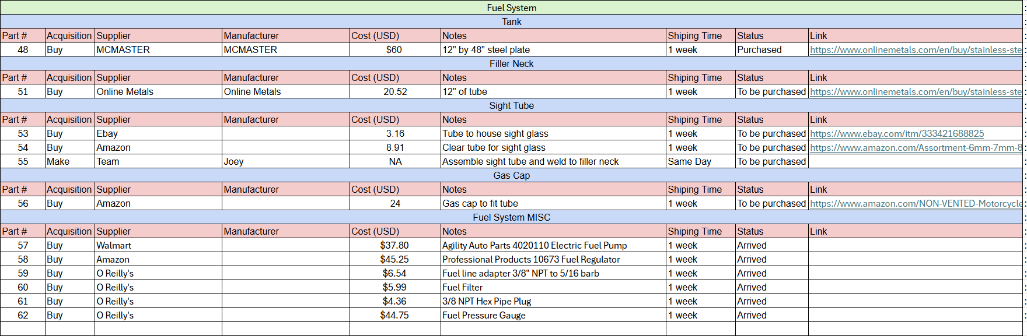
Purchasing Plan - Fuel System

Slide 11
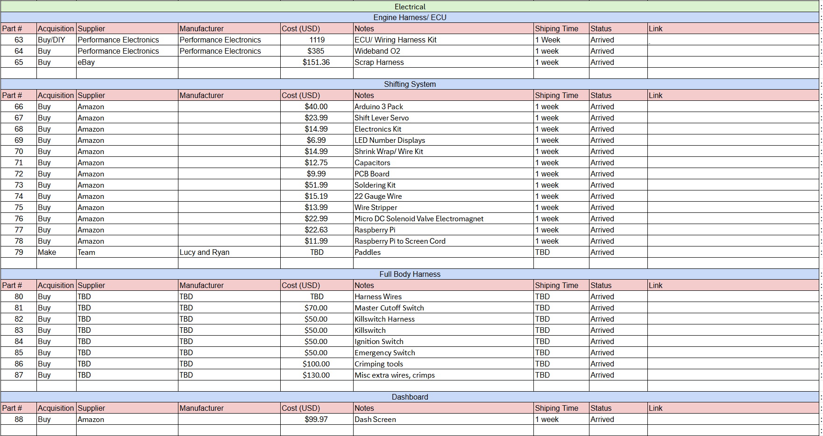
Purchasing Plan - Electrical

Slide 12
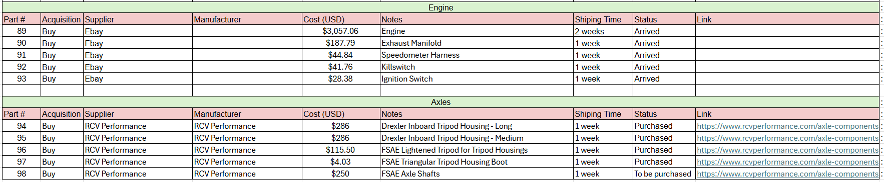
Purchasing Plan - Engine & Axles

Slide 13
Percentage Purchased

Slide 14
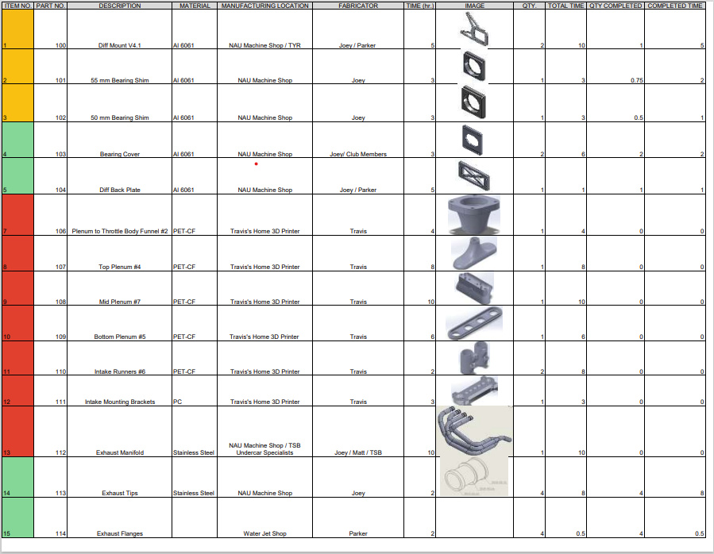
Manufacturing Plan

Slide 15
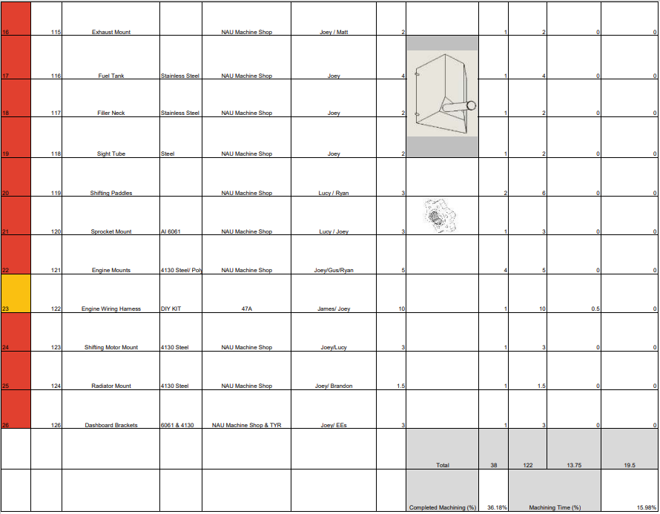
Manufacturing Plan

Slide 16

Demonstrations!

Slide 17
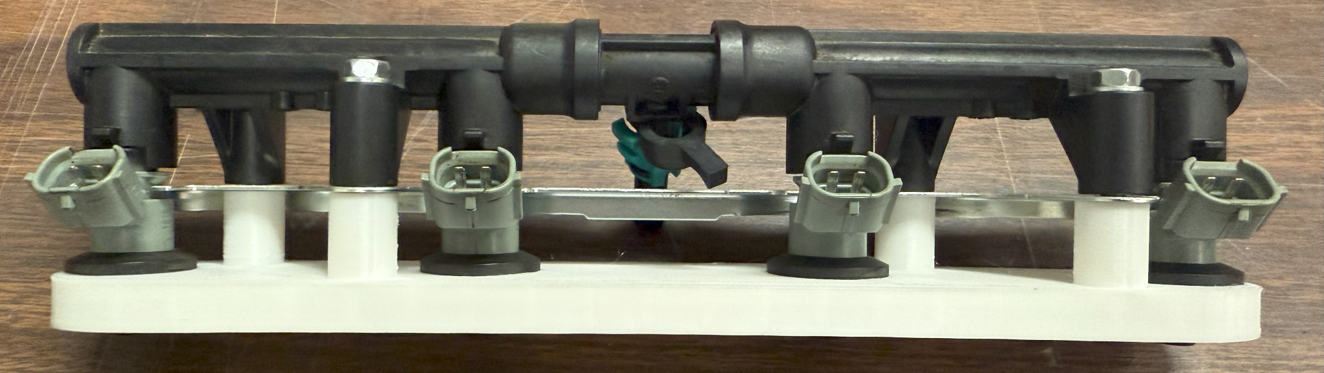
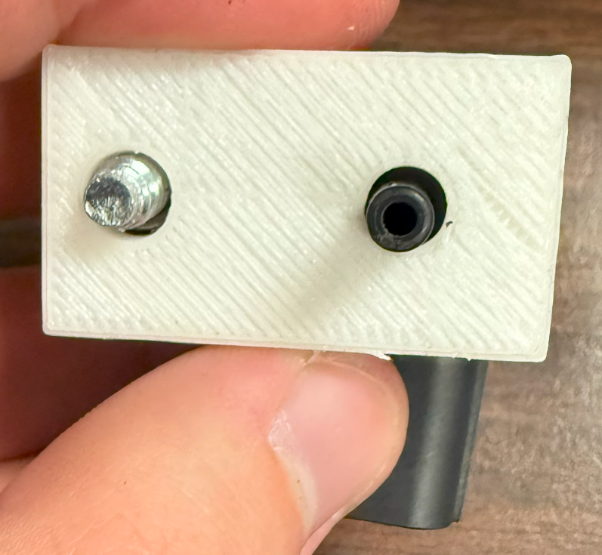
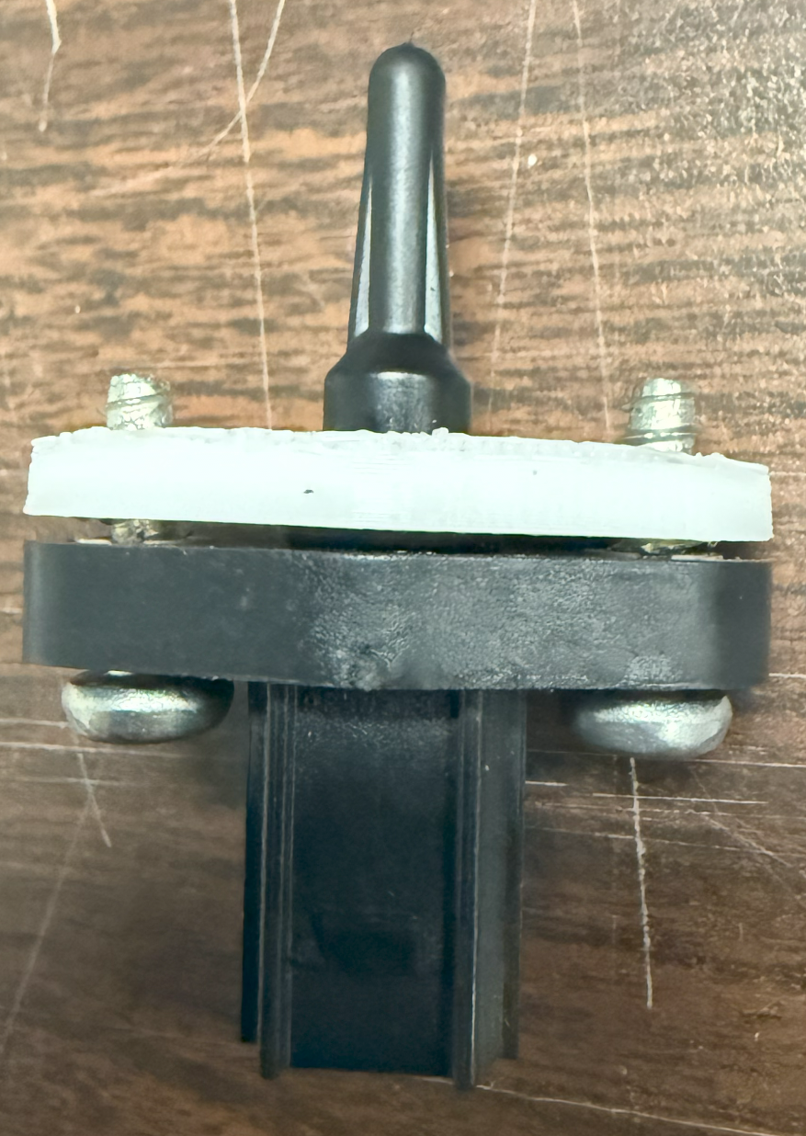
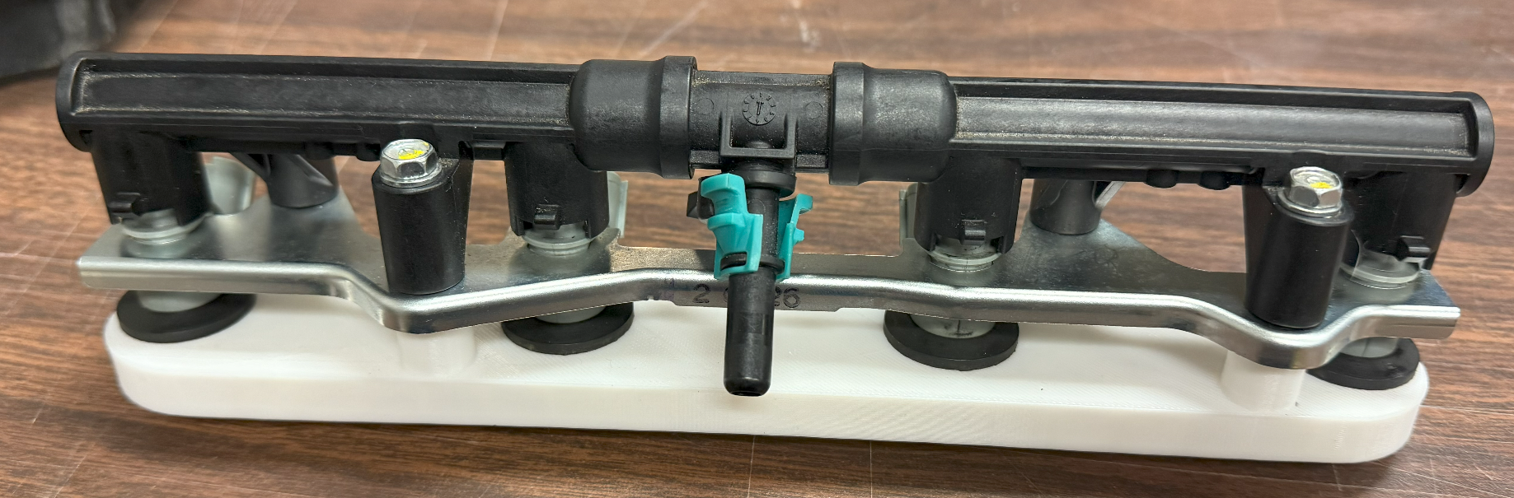
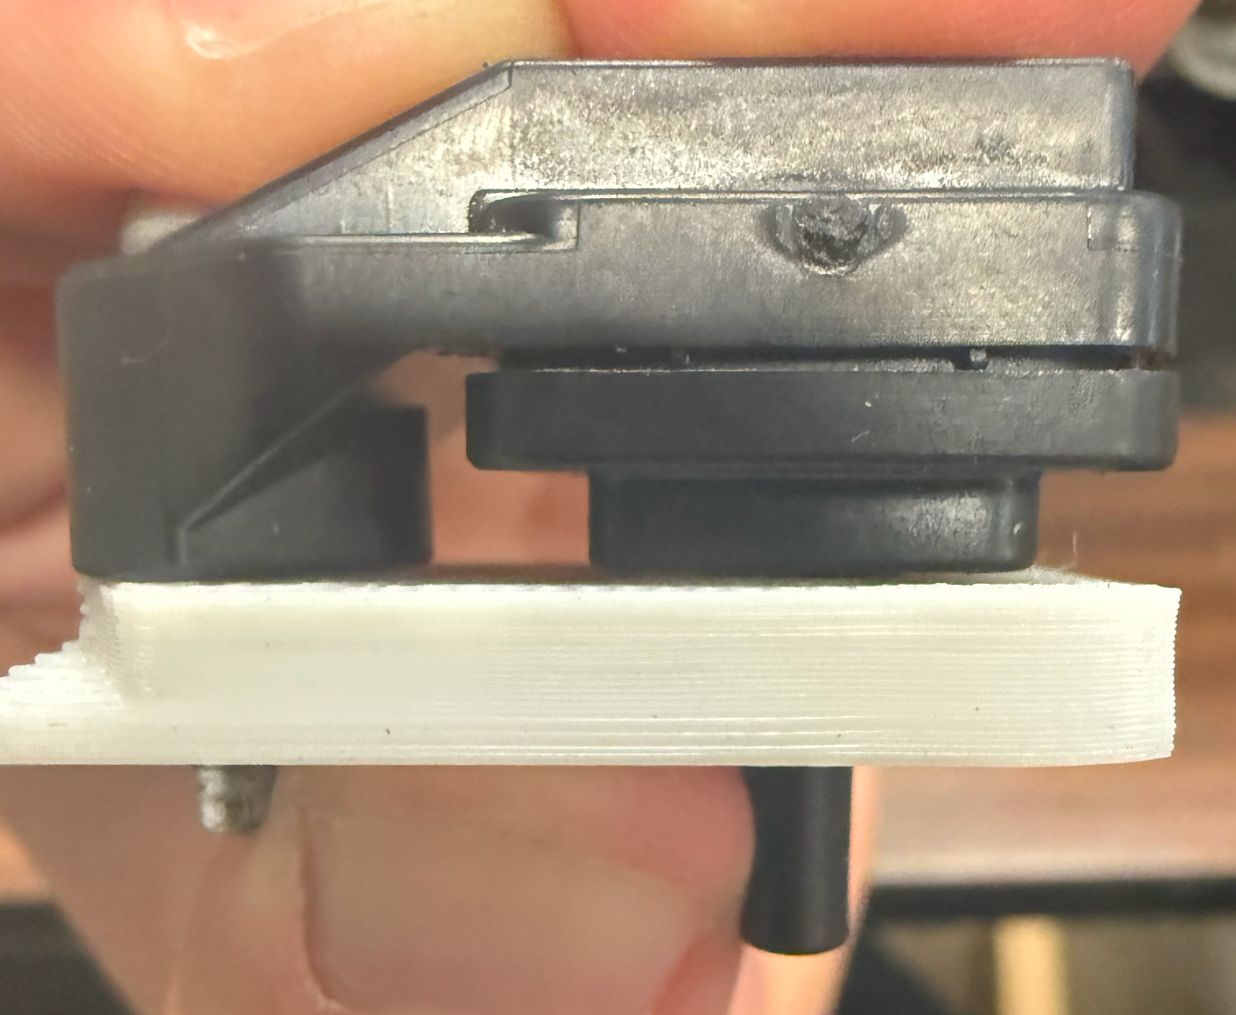
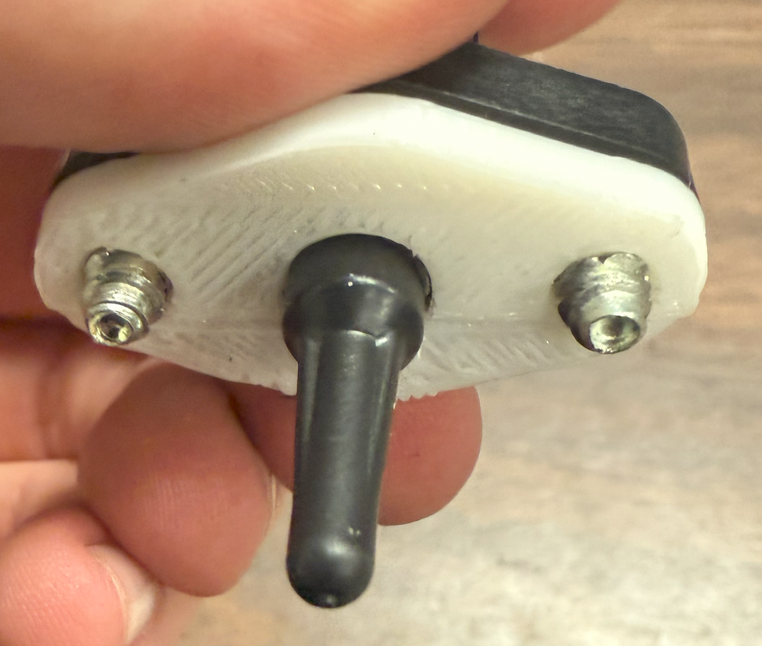
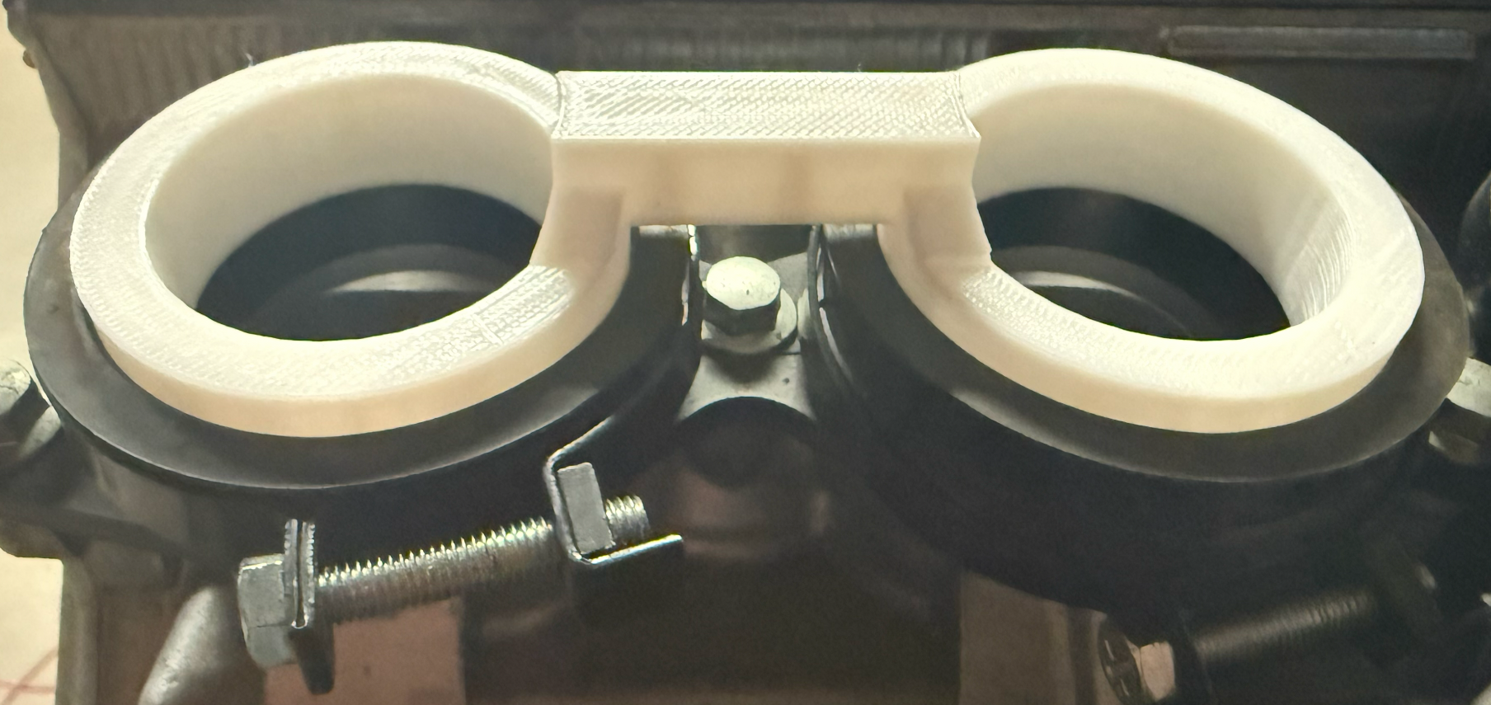
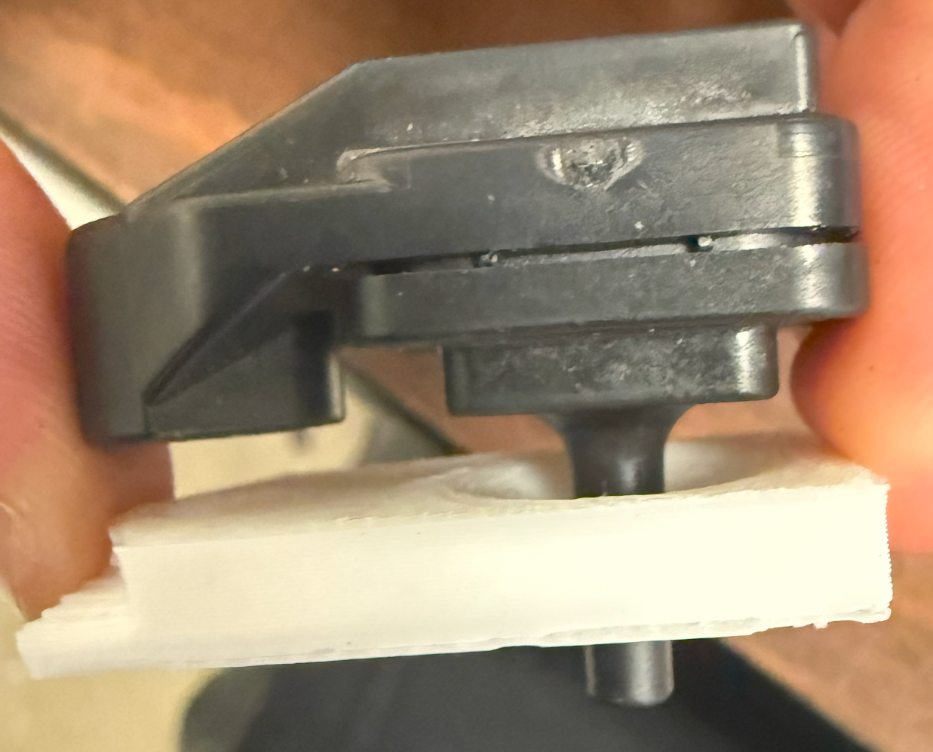
Demonstration: Intake Prototypes

Slide 18
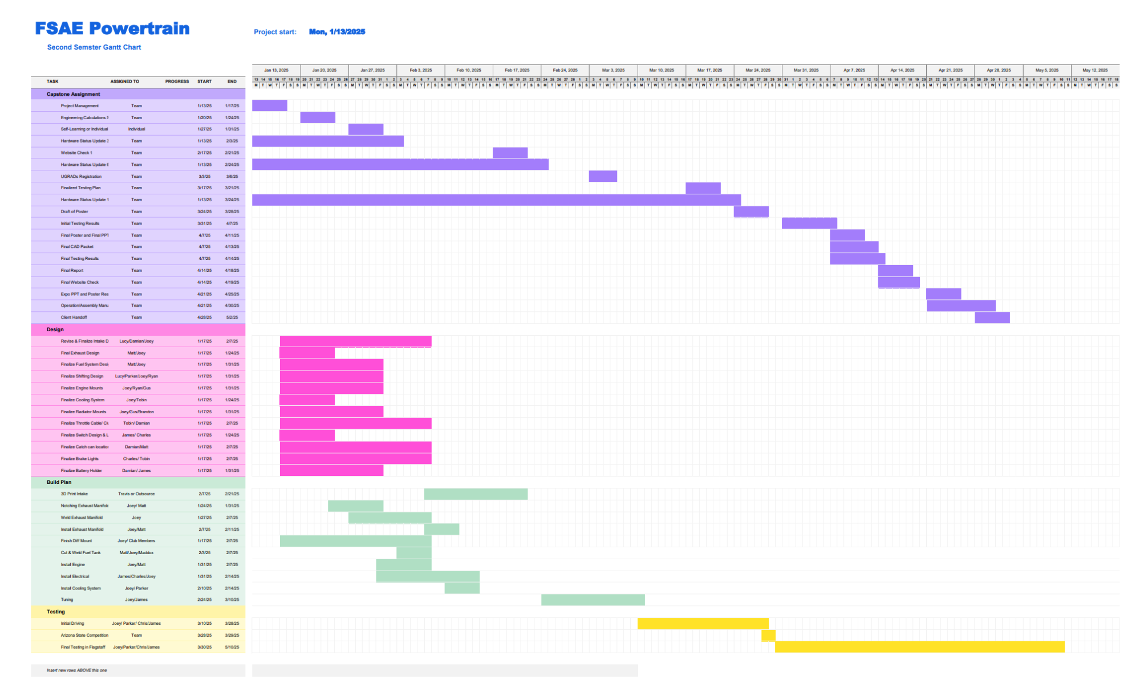
Gantt Chart

Slide 19
QUESTIONS?
THANK YOU

Slide 20
References
[1] J. W, “CBR600RR - CBR -CBR600 Secondary Fuel Rail FSAE,” The GrabCAD, https://grabcad.com/library/cbr600rr-cbr-cbr600-secondary-fuel-rail-fsae-1 (accessed Nov. 15, 2024).
[2] Javier, “CBR 600 system injection,” GrabCAD, https://grabcad.com/library/cbr-600-system-injection (accessed Jan. 15, 2025).

